Slide 1
INTEGRATING
SUPERVISED
AND UNSUPERVISED
LEARNING FOR
ZERO DAY
MALWARE DETECTION
FINAL PROJECT
Presented by:
SANYAM JINDAL (22BAI1192)
Nikunj
Abhishek

Slide 2
Introduction
1. Cybercrime and attack methods have surged since 2019, coinciding with the pandemic, with a notable increase in the number of victims and attacks per hour.
2. The threat landscape has expanded rapidly due to the introduction of new technologies and the digital transformation of businesses, including IoT, cloud hosting, and advanced mobile technologies.
3. Zero-day exploits have seen a dramatic rise across industries, posing significant challenges as they can evade traditional signature and anomaly-based detection methods, as well as antivirus software.
4. To combat these sophisticated threats, frameworks integrating AI, including machine learning and deep learning, alongside traditional techniques, are proving to be more effective in detecting zero-days and other novel malware.

Slide 3
Threat Landscape
Zero-day Attacks
  Exploits of unknown vulnerabilities, or flaws in software and hardware
  Made up 80% of successful incidents involving compromised data.
  Resistant to traditional techniques: antivirus, signature-based, and patching
Notable Zero-days
  Stuxnet- computer worm that targeted Iranian SCADA systems
  Sony hacks- data breach
  RSA attack- zero-day Adobe Flash exploit
  DNC hacks- data breach
Types
  Polymorphic Worms
  Viruses
  Trojans
Methods
  Phishing/spamming (malicious emails)
  Embedding exploits in compromised sites/browsers
  Software/hardware vulnerability hunting

Slide 4
Traditional Cybersecurity Techniques
Signature-based detection
  Repository of signatures of known malware/attacks
  Used for inspecting current programs and activities for malicious code or patterns
  Challenge
      Failure to detect zero-days
      Failure to detect evolving threats: polymorphic and metamorphic malwares
Anomaly-based detection
  Operates on the established baseline of normal or good behavior and activities
  Detect patterns of deviations or anomalous activity
  Challenge
      Susceptibility to high false alarm rate

Slide 5

Proposed Strategy
AI-based framework combining supervised and unsupervised Machine learning in addition to traditional cybersecurity practices
Supervised Machine Learning
  Rapidly analyze large volumes of data
  generated in system
  Models train and learn from their own
  evolving sample sets
  Automating tasks: threat detection,
  response, and classifying new threat patterns
  Powerful computational analysis improves accuracy of threat detection
Challenge (Supervised)
  Detecting novel malware
  Building precise classification models
Unsupervised Machine Learning
  Utilizes unlabeled data sets, without the
  need for human intervention to discover:
    Unknown relationships
    Trends
    Key patterns within data
  Capable of revealing previously unknown insights and making predictions
  Generates vast amounts of probability- based calculations to:
    Detect new threat patterns and novel malware
    Establish normal behaviors and deviations
    Detect unseen threats or zero-days (without relying solely on past threat information)

Slide 6
HYBRID LEARNING APPROACH
1. **Overview of the Two-Level Hybrid Learning Method**:
This approach is designed to tackle the challenge of detecting zero-day malware, which refers to previously unseen malware variants that evade traditional signature-based detection methods. It operates on two levels: the macro-level classifier and the micro-level classifiers.
2. **Macro-level Classifier (Random Forest)**:
At the macro-level, a Random Forest algorithm is employed to make high-level decisions regarding the nature of incoming data flows. The role of this classifier is pivotal as it serves as the first line of defense in determining whether a given flow is malicious or benign. Random Forest is chosen for its robustness and ability to handle large datasets with high-dimensional feature spaces. By analyzing various features extracted from the data, the macro-level classifier aims to provide an initial assessment of the threat level associated with the flow.
3. **Micro-level Classifiers (Single-class SVMs)**:
In conjunction with the macro-level classifier, the micro-level classifiers, consisting of multiple Single-class Support Vector Machines (SVMs), play a crucial role in enhancing the detection capability, especially for identifying specific classes of malware. Each Single-class SVM model is specialized in categorizing instances belonging to a particular malware class. Unlike traditional SVMs that are trained on binary classification tasks, Single-class SVMs are trained on only one class of data, which in this context would be instances of a particular malware type. This specialization enables the micro-level classifiers to detect subtle patterns and characteristics associated with different malware families or variants, thereby improving the overall accuracy and reliability of the detection system.

Slide 7
SINGLE
CLASS
SVM
Single-class Support Vector Machines (SVMs) are a variant of traditional SVMs designed for anomaly detection tasks, where the objective is to identify instances belonging to a specific class. Here's a detailed explanation:

Slide 8
Explanation of Single-class SVMs: Single-class SVMs are trained on data from a single class, aiming to construct a hypersphere (or hyperplane in high-dimensional spaces) around the majority of the data points representing that class. This hypersphere encloses the normal instances while maximizing the margin from the boundary to capture outliers or anomalies.
Construction of Hyperspheres: To construct hyperspheres for each malware class, Single-class SVMs iteratively optimize an objective function. This function aims to find the smallest hypersphere enclosing a predefined proportion of training instances (e.g., 95% of the instances). By adjusting parameters during training, the SVM seeks to minimize the radius of the hypersphere while maintaining the containment of the majority of the class instances.
Zero-Day Malware Detection Strategy: In the context of zero-day malware detection, Single-class SVMs are used to detect anomalies or instances lying outside the hyperspheres of known malware classes. When a new instance is encountered during testing, if it falls outside any of the hyperspheres corresponding to known malware classes, it is flagged as a potential zero-day malware threat. This strategy enables the detection of previously unseen malware variants by identifying deviations from the normal behavior learned during training.

Slide 9
DATASET
AND
EVALUATION
Description of Data Set: The CIC-IDS-2018 data set is commonly used for evaluating intrusion detection systems. It contains a diverse range of network traffic data captured in a simulated environment, including features related to packet headers, payload characteristics, and flow statistics.

Slide 10
Class Labels and Partitioning: Class labels are assigned based on the presence or absence of malware in network flows. The data set is partitioned into training and test sets, with a portion of the instances reserved for training the Single-class SVMs and the remaining used for evaluating the model's performance.
Containing labeled traffic data captured in a realistic network environment, the CICIDS 2018 dataset offers researchers and practitioners insights into the behavior of different network protocols, applications, and services. With its diverse set of network traffic features, including packet headers, payload characteristics, and connection statistics, the dataset enables detailed analysis and modeling of network traffic patterns.
Overall, the CICIDS 2018 dataset serves as a valuable resource for advancing cybersecurity research, providing a realistic and representative sample of network traffic data for experimentation, benchmarking, and developing effective defense strategies against evolving cyber threats.
Performance Metrics: Performance metrics such as F1 Score and Area Under the Receiver Operating Characteristic Curve (AUC ROC) are commonly used to evaluate the effectiveness of malware detection systems. The F1 Score provides a balance between precision and recall, while AUC ROC measures the classifier's ability to distinguish between malware and benign instances across various thresholds.

Slide 11
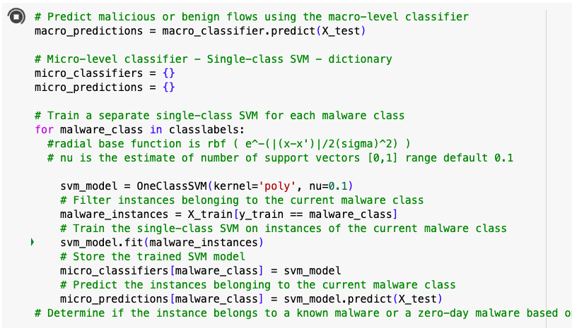
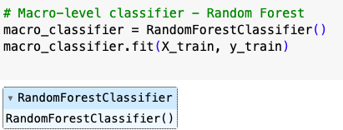
CLASS LABELS
MODELS USED
IN PROJECT

Slide 12
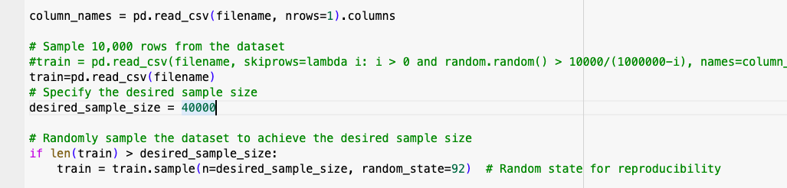

1. THE FIRST TRAINING AND TESTING HAS BEEN DONE 40,000 SAMPLES SELECTED RANDOMLY

Slide 13
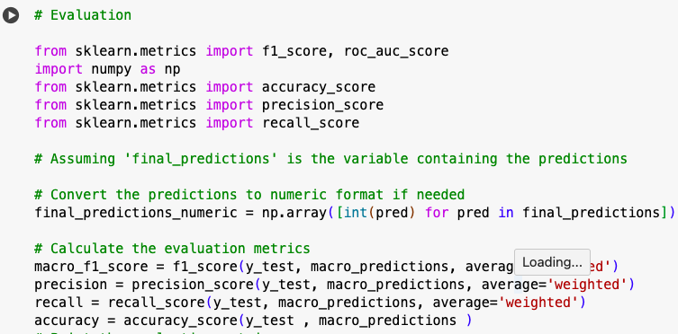
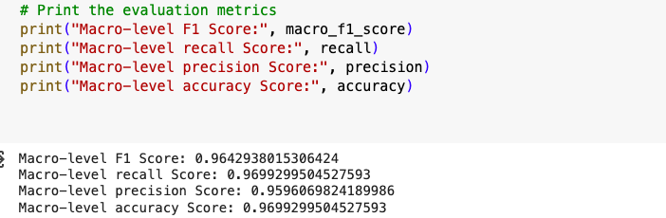
MACRO LEVEL PREDICTION

Slide 14
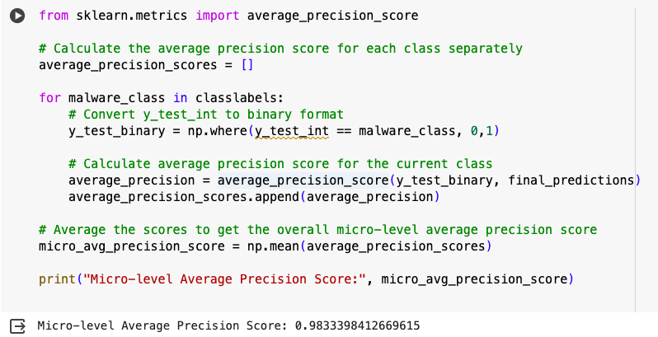
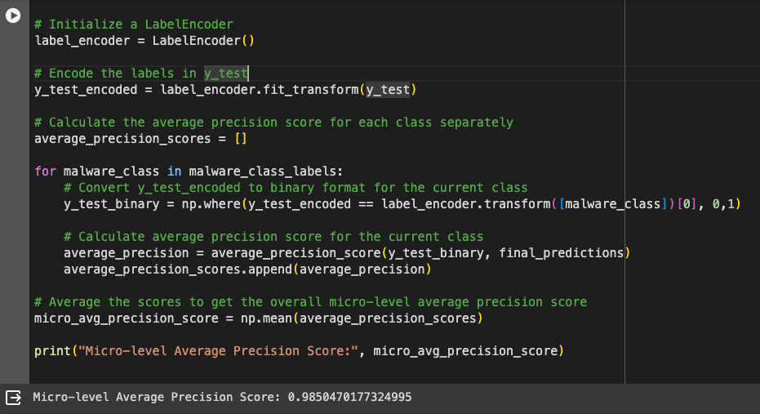
MICRO LEVEL PREDICTION
USING AVERAGE PRECISION SCORE

Slide 15
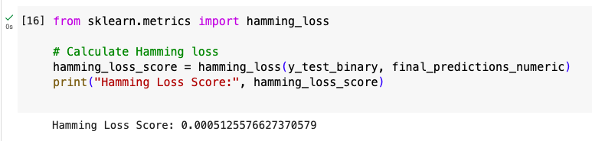
USING HAMMING LOSS EVALUATION METHOD
In the context of Hamming loss, a score is predicted within the range of 0 to 1. Lower scores indicate higher model accuracy, with 0 representing perfect accuracy and 1 indicating complete inaccuracy.

Slide 16
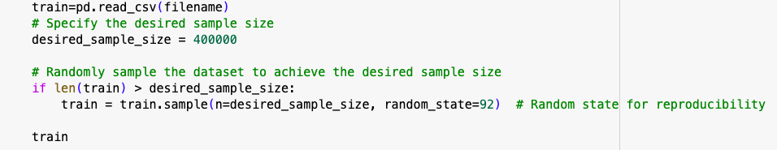

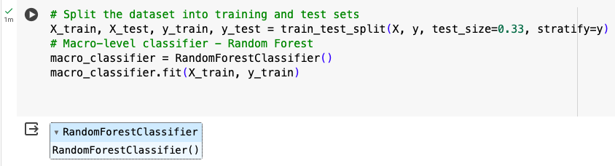
2. THE SECOND TRAINING AND TESTING IS BEING DONE FOR 4,00,000 SAMPLES SELECTED RANDOMLY

Slide 17
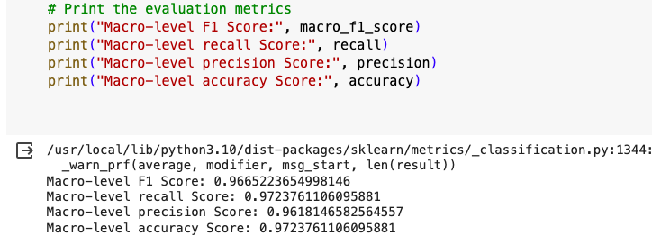
MACRO LEVEL PREDICTION

Slide 18
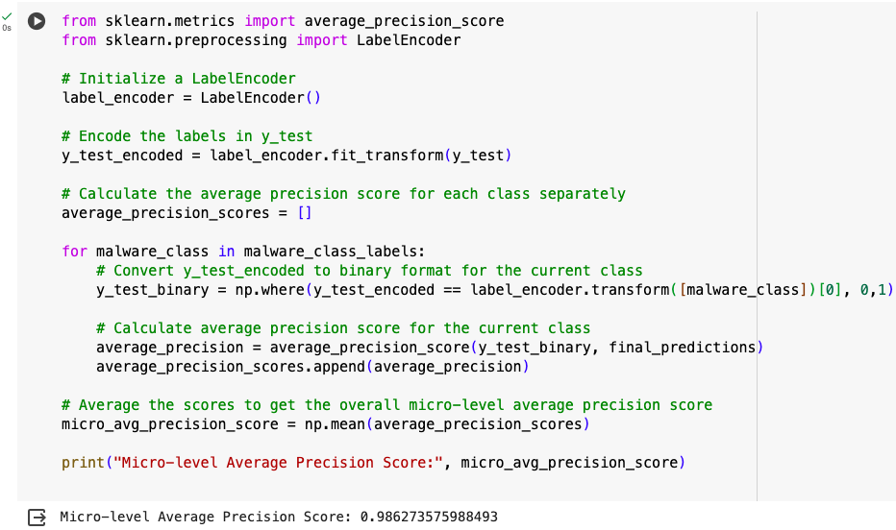
MICRO LEVEL PREDICTION
USING AVERAGE PRECISION SCORE

Slide 19
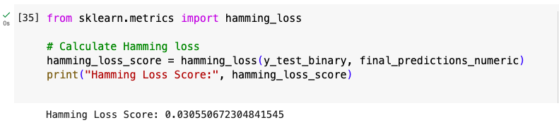
USING HAMMING LOSS EVALUATION METHOD
In the context of Hamming loss, a score is predicted within the range of 0 to 1. Lower scores indicate higher model accuracy, with 0 representing perfect accuracy and 1 indicating complete inaccuracy.

Slide 20
Experimental Results

Slide 21
Results of Macro-level Classifier:
The macro-level classifier, employing the Random Forest algorithm, demonstrates strong performance in detecting both known malware and zero-day malware instances. It achieves high accuracy in distinguishing between benign and malicious flows, showcasing its effectiveness as the initial screening mechanism.
In terms of F1 Score,Accuracy,Precision and Recall on malicious classes, the macro-level classifier exhibits robust performance, indicating its ability to achieve a balance between precision and recall in identifying various types of malware.
We got a ~96+% score in all evaluation parameters while testing for macro level classifier.

Slide 22
Results of Micro-level Classifiers:
The micro-level classifiers, consisting of Single-class SVM models specialized in detecting specific malware classes, yield promising results in detecting zero-day malware.
The Average Precision Score for zero-day malware detection reflects the overall discriminatory power of the micro-level classifiers in distinguishing between normal and anomalous instances, including zero-day malware.Using Average Precision Score an accuracy of 98.6+% was achieved.

Slide 23
CONCLUSION

Slide 24
In conclusion, our study revealed intriguing insights into the relationship between training sample size, classification accuracy, and Hamming loss error in the context of the CICIDS 2018 dataset for network traffic flow analysis.
With a dataset size of 40,000 samples, we observed a notable trade-off between classification accuracy and Hamming loss error. While the accuracy metrics showed a decrease due to the limited training data, the Hamming loss error exhibited a more favorable performance. This suggests that despite the lower accuracy, the model demonstrated improved precision in multi-label classification, indicating its ability to correctly predict the presence or absence of multiple attack types within network traffic flows.
Conversely, when we increased the training sample size to 400,000 we observed a significant improvement in classification accuracy across both macro and micro level classifiers. This larger dataset facilitated better model generalization and resulted in higher accuracy rates, reflecting the model's enhanced ability to accurately classify network traffic instances.
However, intriguingly, the Hamming loss error showed an unexpected increase with the larger training sample size. Despite the improved accuracy, the higher Hamming loss suggests a greater discrepancy between the predicted and actual labels for each sample, indicating a decrease in precision at the multi-label classification level.
These findings underscore the importance of considering both accuracy and Hamming loss error metrics when evaluating the performance of multi-label classification models for network traffic analysis. While larger training sample sizes may lead to improved accuracy, they may not necessarily translate to better precision in multi-label classification tasks. Thus, achieving a balance between sample size, classification accuracy, and Hamming loss error is essential for developing robust and reliable intrusion detection systems and network anomaly detection algorithms in real-world cybersecurity applications.

Slide 25
Thank You

